Slide 1
The Daily Meal
Easy solution to daily cooking dilemma

Slide 2

Presenters’ list
Sindhusha Paluri
Pranali Mhatre
Preetu Singh
Bansari Patel

Slide 3
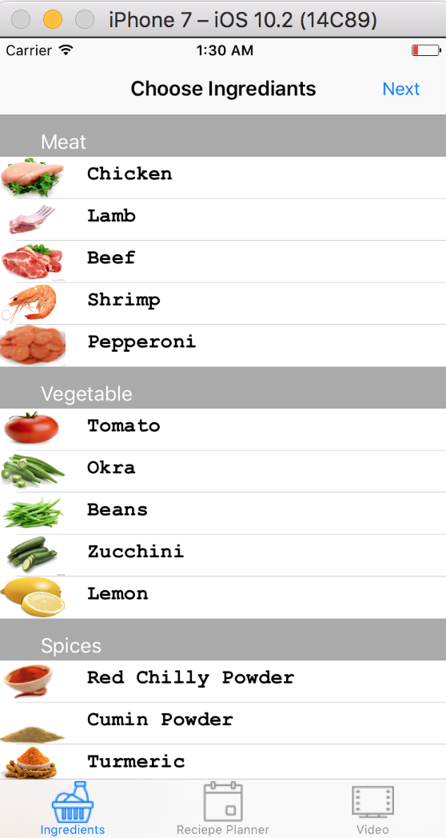
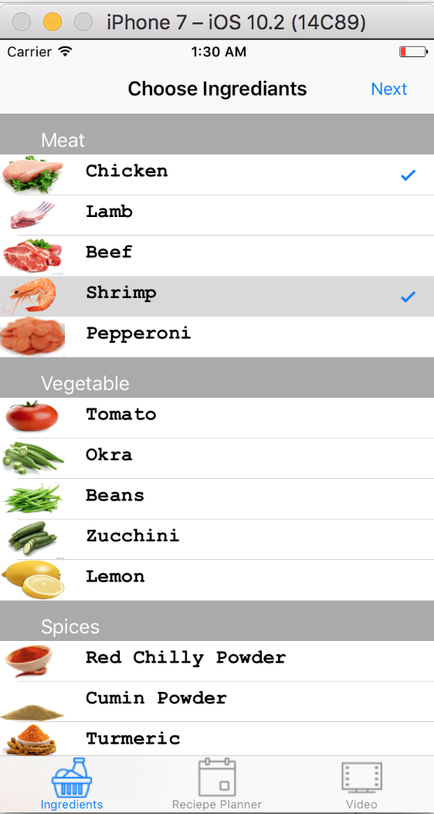
UI Design

Slide 4
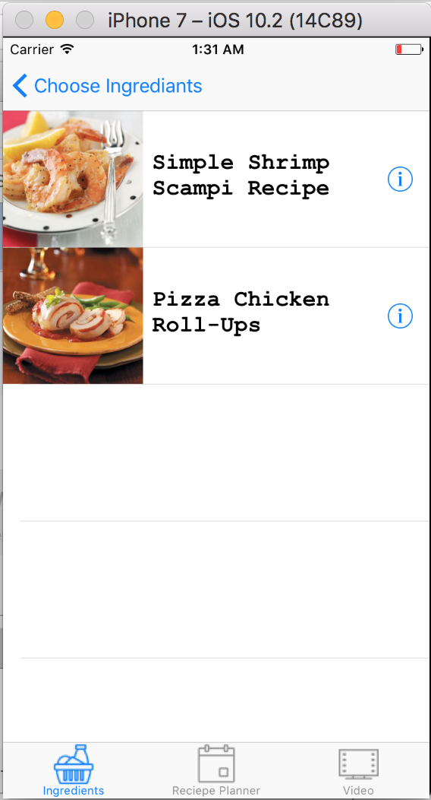
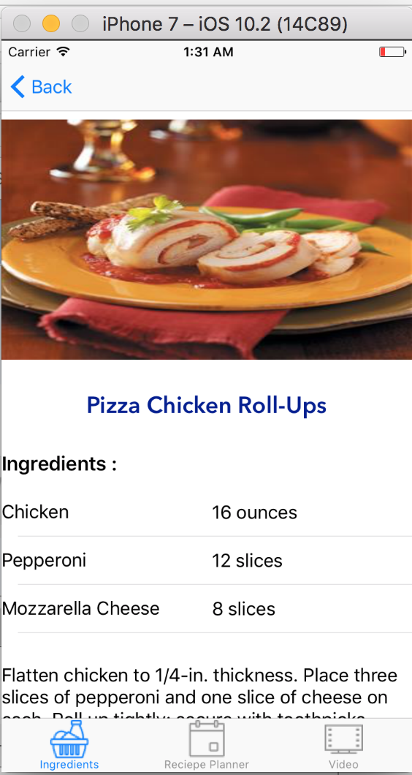
UI Design

Slide 5
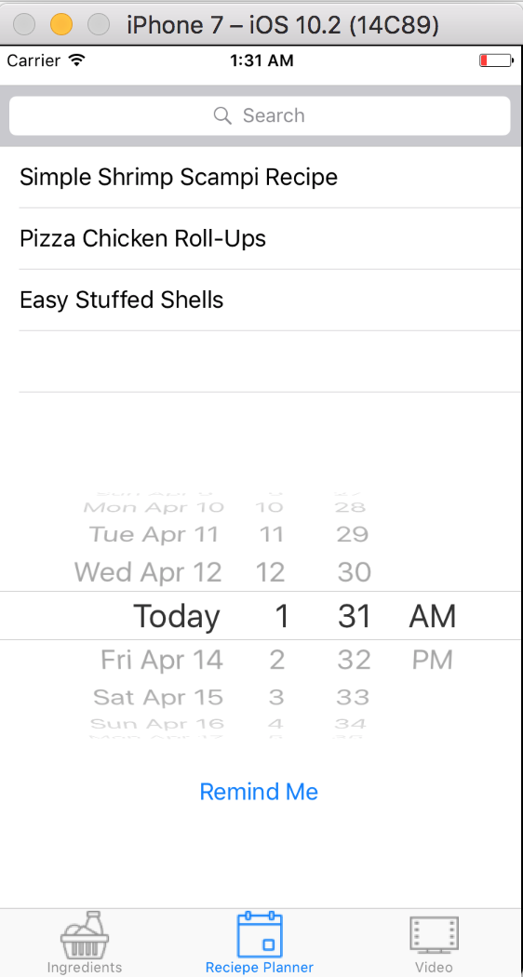
UI Design

Slide 6
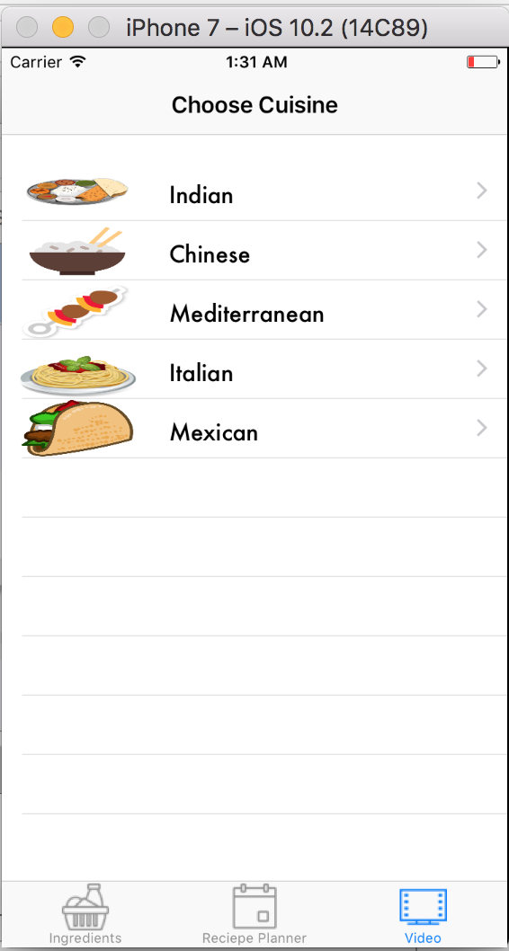
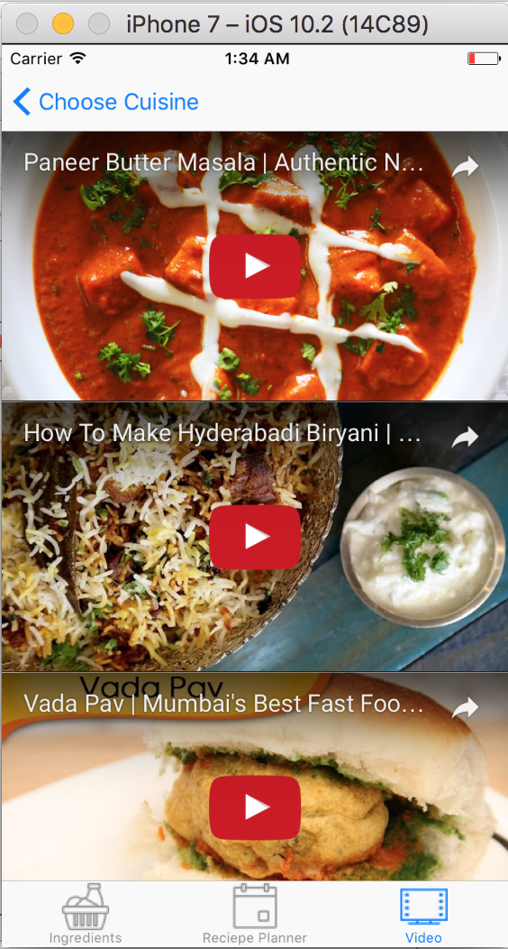
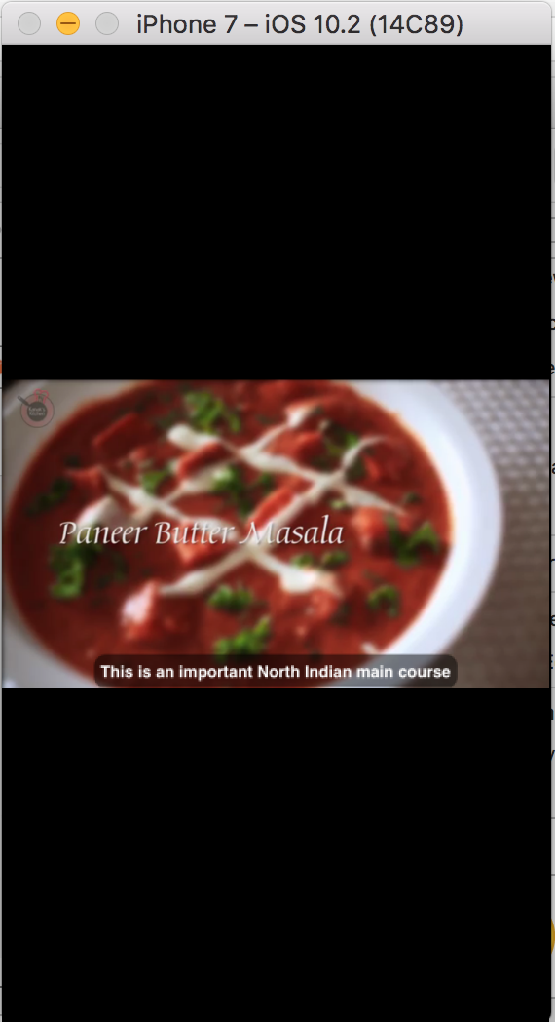
UI Design

Slide 7
Knowledge Points
Button Control, Labels, Image View
Text Field and Software Keyboard
Data Persistence With SQLite3 (.sqlite)
Multiview Applications (multiple pages)
Table View
Navigation
Reminder

Slide 8
Additional Knowledge Points
Navigation
Reminder

Slide 9


